Slide 1
CARRY LOOKAHEAD ADDERS
Lecture 17a_CLA
Reference : Section 5.4.1 of Textbook

Slide 2
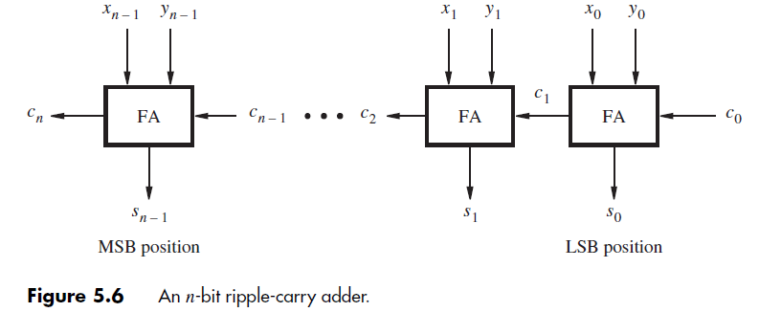

Ripple carry adder

Slide 3
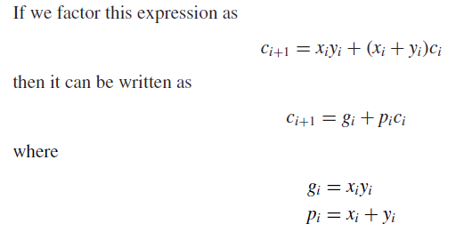

Slide 4
Applying the equation to the carrystages obtains the form given below
C₂=g₁+p₁[g₀+p₀c₀]=
C_{n}=g_{n-1}+p_{n-1}c_{n-1}
C₂=g₁+p₁c₁
C₁=g₀+p₀c₀

Slide 5
In general all carry equations needs to be expanded to the form,

Slide 6
